Slide 1
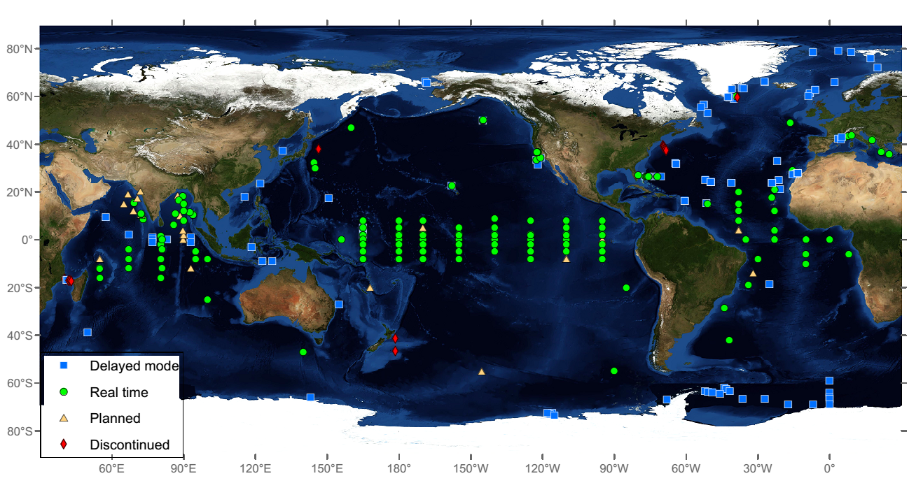

are “Flux” Stations supported by NOAA are “Transport” Stations supported by NOAA
NOAA Contributions to OceanSITES
Papa
CCE
WBTS
KEO
NTAS
WHOTS
ITF
MOVE
SAM
Stratus
TMBA
Solomon Sea
Weddell Sea
As of April 2015

Slide 2
The Kuroshio Extension Observatory (KEO) and NOAA Station Papa surface moorings are part of the NOAA PMEL Ocean Climate Stations project http://www.pmel.noaa.gov/OCS/
NOAA Papa Surface Mooring
(started in 2007)
KEO
(started in 2004)
As of April 2015

Slide 3
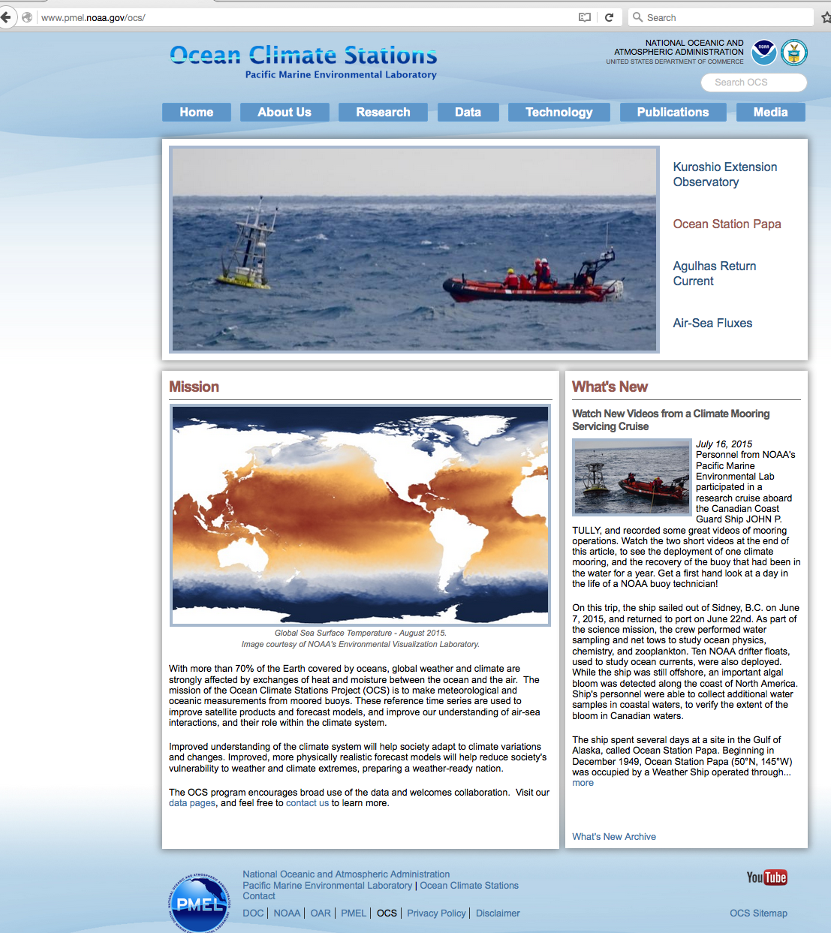
New Website!
www.pmel.noaa.gov/OCS

Slide 4
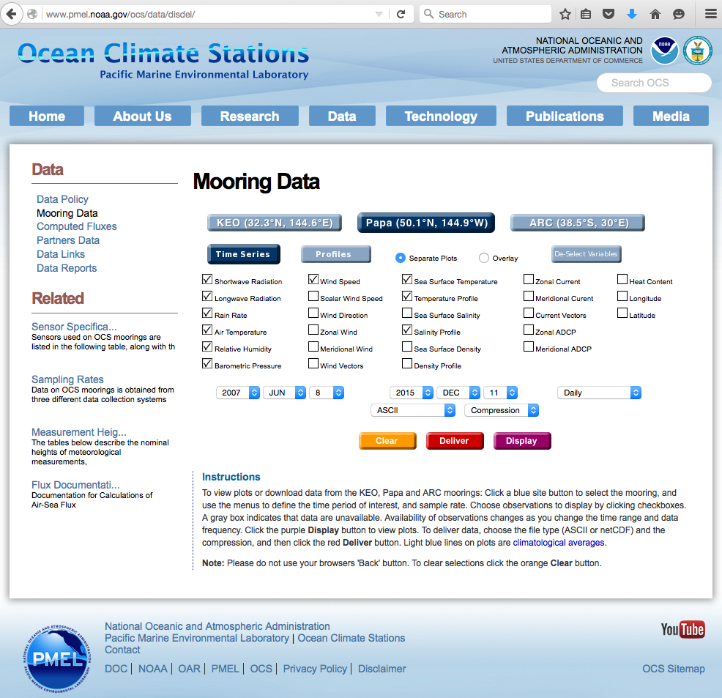
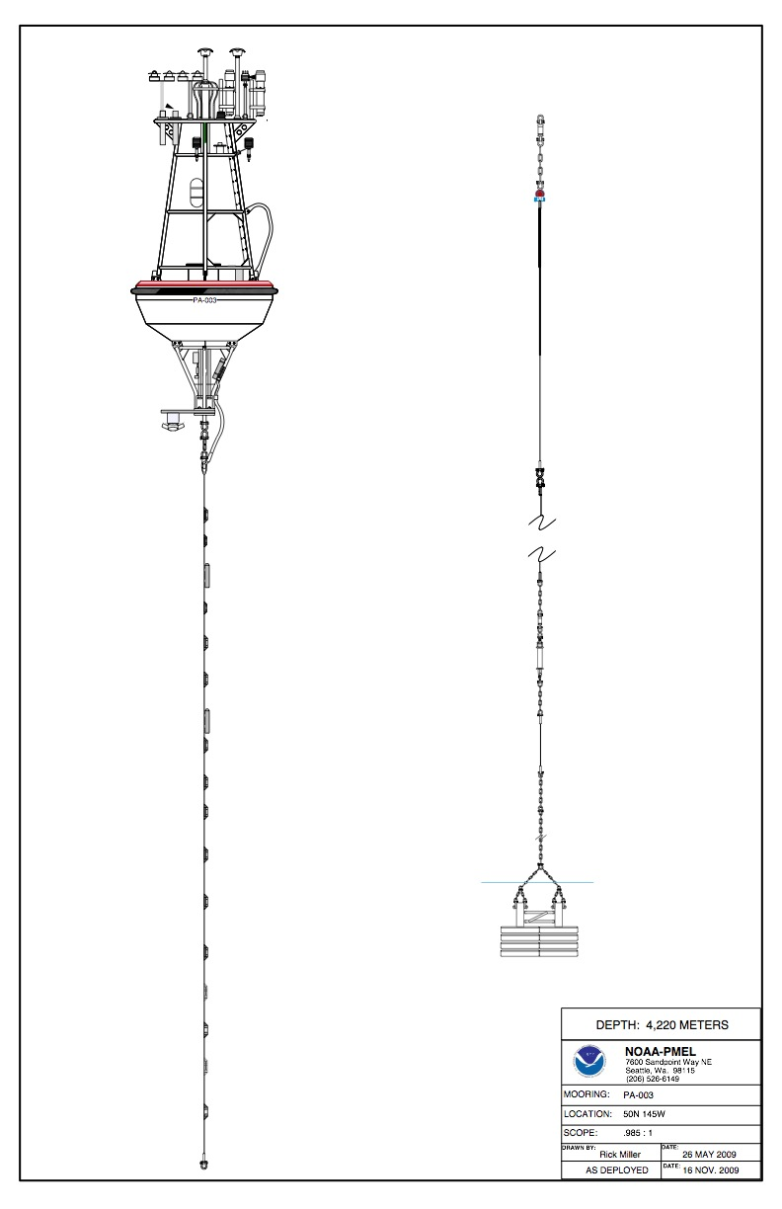
Station Papa Mooring
SWR-LWR
Rain
Wind
AT,RH
BP
Wind
ATRH
SST&SSS
ADCP
U,V at 15m,
& 35m
T upper 300m
S upper 200m
Deep TS & P on release
http://www.pmel.noaa.gov/ocs/data/disdel/
Notes:
The NOAA Ocean Climate Stations surface mooring data can be accessed from an easy to use display and delivery webpage shown here. URL is www.pmel.noaa.gov ocs data disdel
In FY15, OCS web pages received over 186,000 site hits, showing an increase of more than 10k over FY14. The amount of text and data downloaded by visitors increased by nearly a factor of four over FY14, going from 247 GB in FY14 to 983 GB downloaded in FY15. The OCS Data Display and Delivery page had 1,427 download requests, yielding over 7,000 data files to users from around the world (US, Japan, Canada, China, Sweden, South Korea). This is another large increase over previous years. From FY13 to FY14, there was more than a factor of two increase in the number of data file requests, and more than a factor of three increase in the number data files provided. Again, from FY14 to FY15, download requests increased by a factor of three (500 to 1,427), and the number of files provided also increased by more than three times (1,900 to 7,000). Interest and use of OCS data continues to rise.

Slide 5
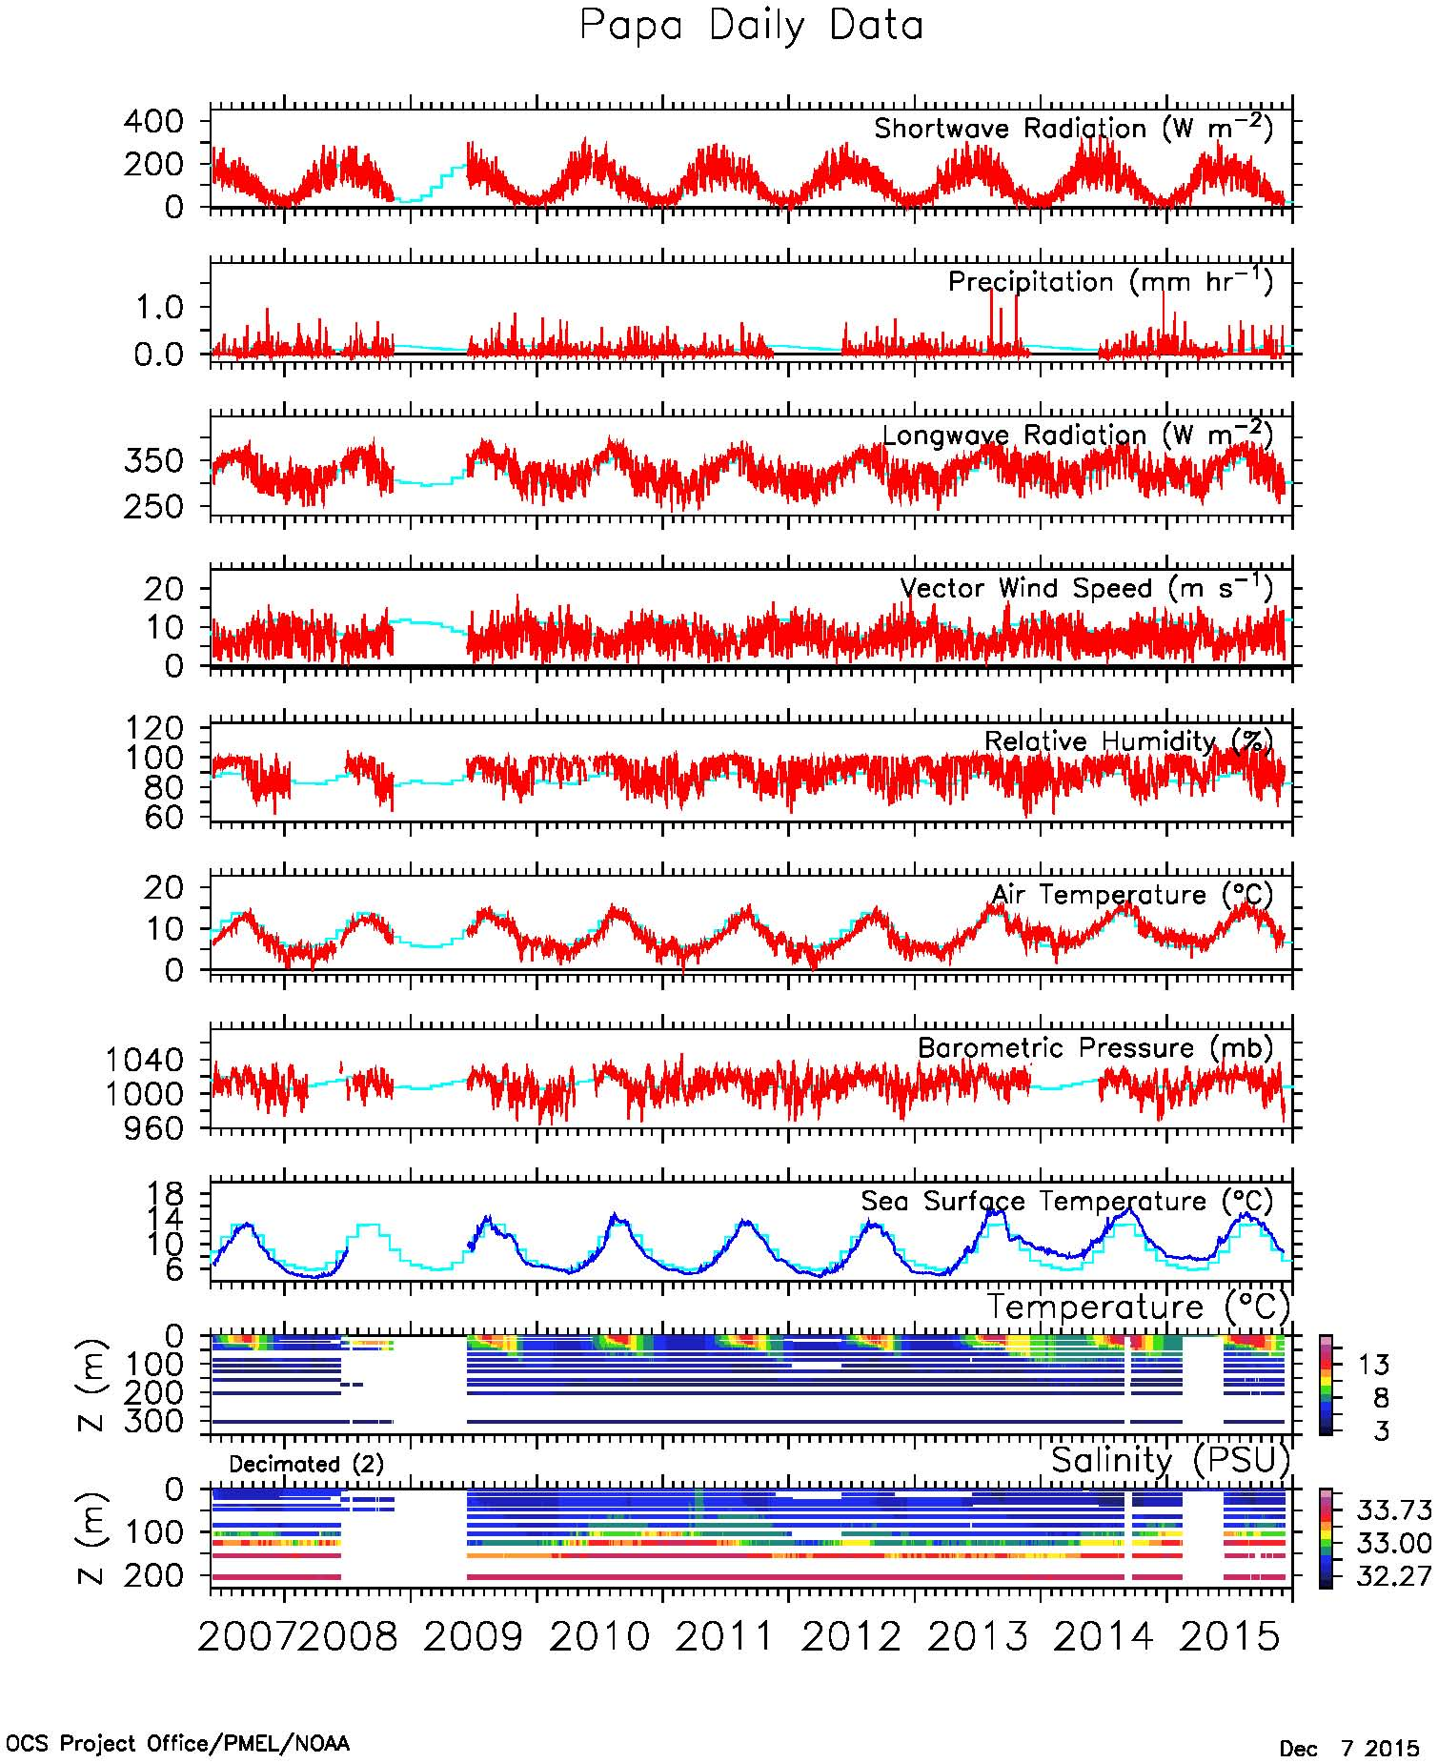
Station Papa Mooring
SWR-LWR
Rain
Wind
AT,RH
BP
SST&SSS
ADCP
U,V at 15m,
& 35m
T upper 300m
S upper 200m
Deep TS & P on release
http://www.pmel.noaa.gov/ocs/data/disdel/
Notes:
This slide shows daily averaged data from Station Papa, generated from the project data display and delivery page.
Including… solar radiation, precipitation, longwave radiation, wind speed, relative humidity, air temperature, atmospheric pressure, SST and SSS.
While the data goes right up to the present, I will be using only this data from June 2007 – June 2013.

Slide 6
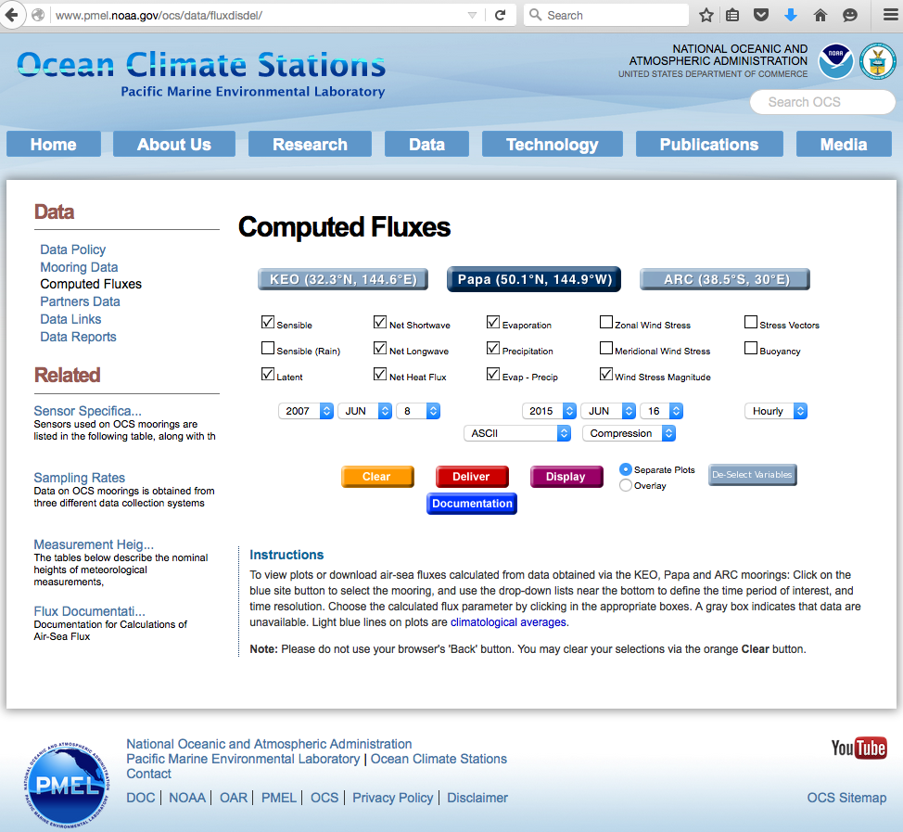
Notes:
From these data we can then calculate the turbulent and radiant heat fluxes. These we have just recently made available through another easy to use webpage that can be accessed through our data pages.

Slide 7
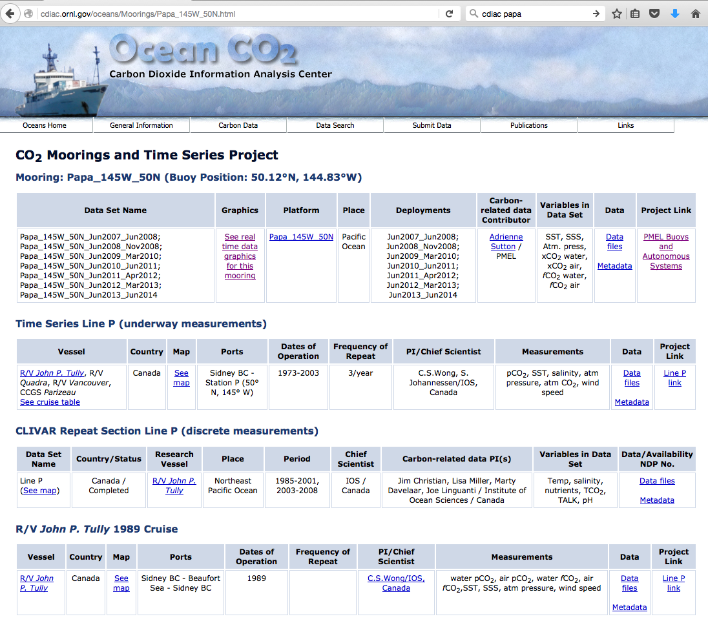
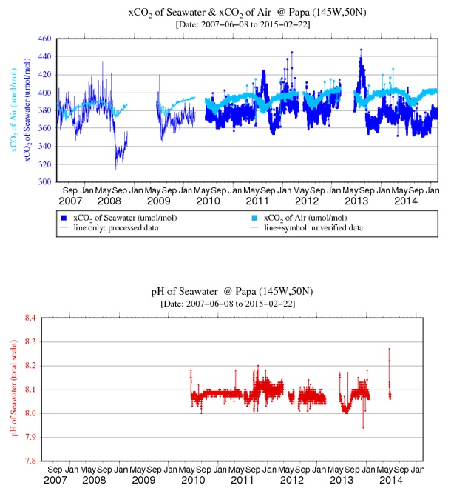
BP
Air pCO₂
Sea pCO₂
SST,SSS
Fluorometer
-Turbidity
pH
GTD-O₂-CTD
pCO_{2 (air and sw),} pH, Fluorometer-Turbidity -- A. Sutton
GTD-O₂-CTD -- S. Emerson
http://www.pmel.noaa.gov/co2/story/Papa
Notes:
FYI: I expect we will have data available on CDIAC up to 2013 by the end of this FY (a major focus of our new hire coming on next month).

Slide 8
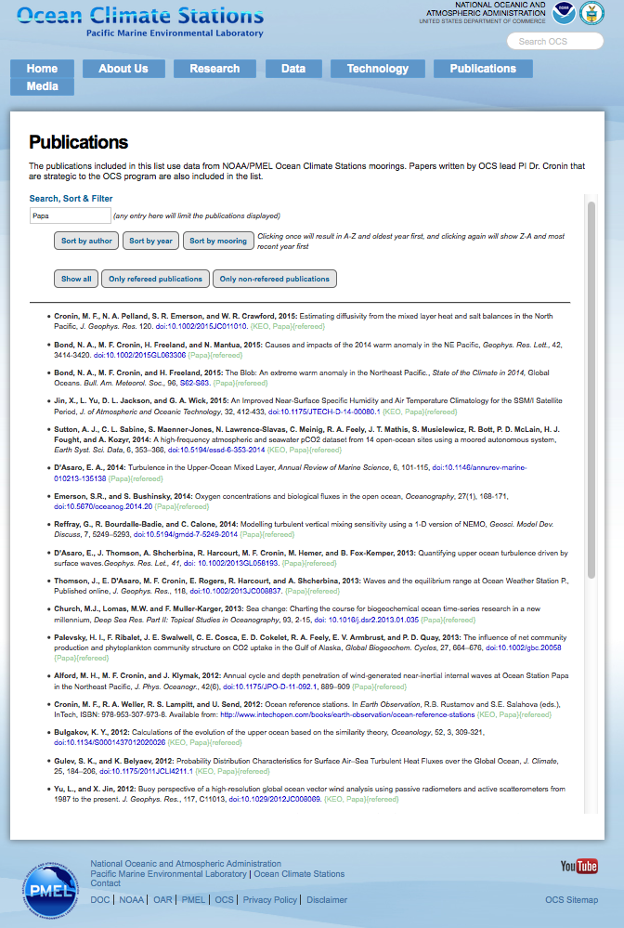
30 Known Refereed Papers involving NOAA Surface Papa Mooring
Please notify Meghan.F.Cronin@noaa.gov about new papers!
Notes:
30 known refereed papers using Papa data --- Any more?

Slide 9
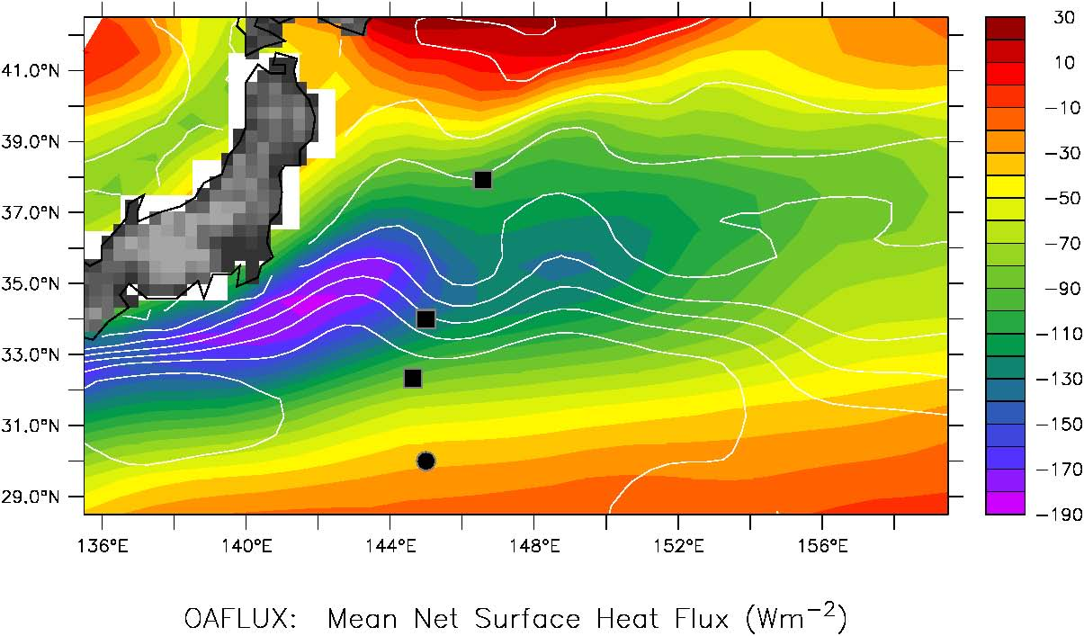
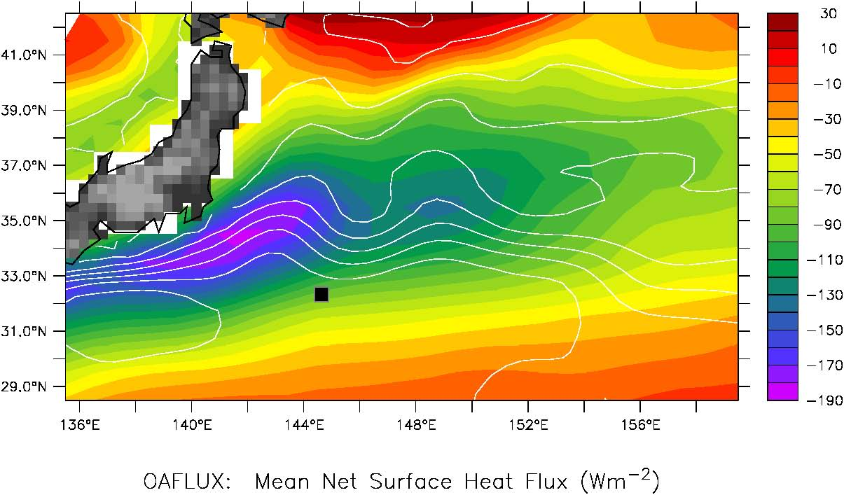
JKEO (JAMSTEC Surface Mooring)
Prior to 2014
NKEO (JAMSTEC–HOTSPOT Surface Mooring)
KEO (NOAA Surface Mooring)
S1 (JAMSTEC BGC moorings)
After 2014
KEO (NOAA Surface Mooring & JAMSTEC Sediment Trap)

Slide 10
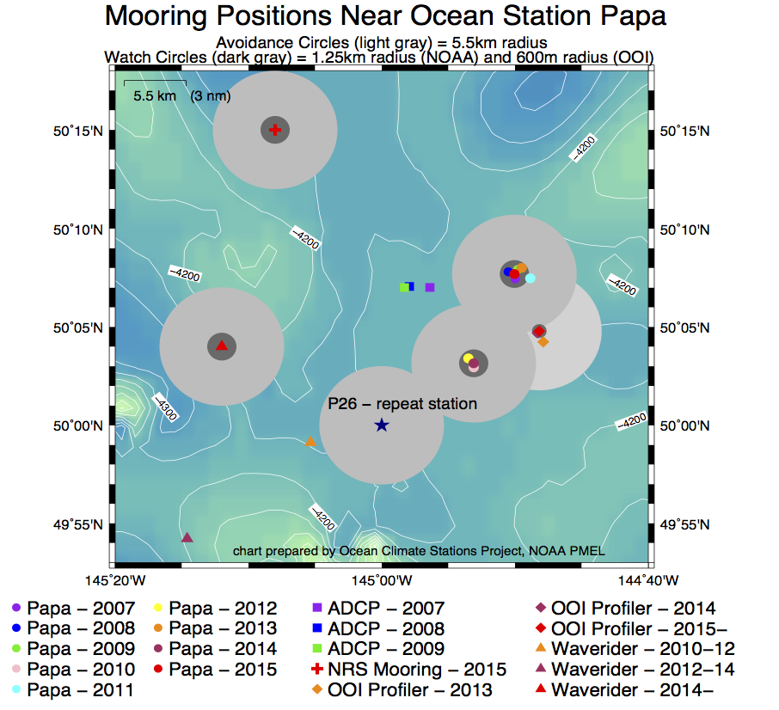
NOAA NRS02 (sub-surface)
Noise Reference Station
NOAA Papa-2015 surface flux mooring
NSF OOI subsurface profiler mooring
UW/APL Waverider surface mooring
NOAA Papa-2016
Surface flux mooring

Slide 11
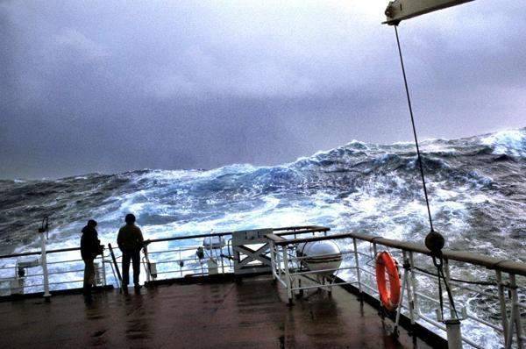
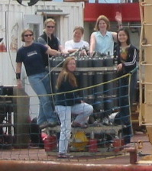
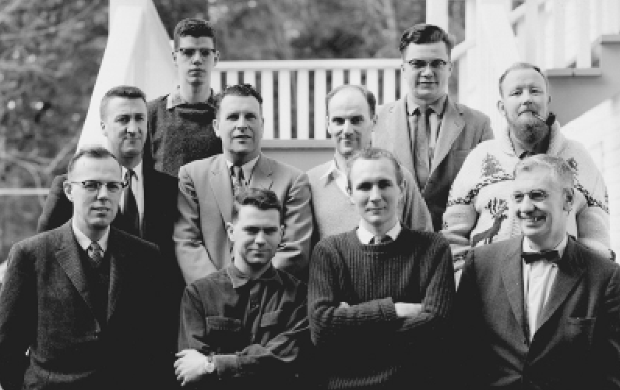
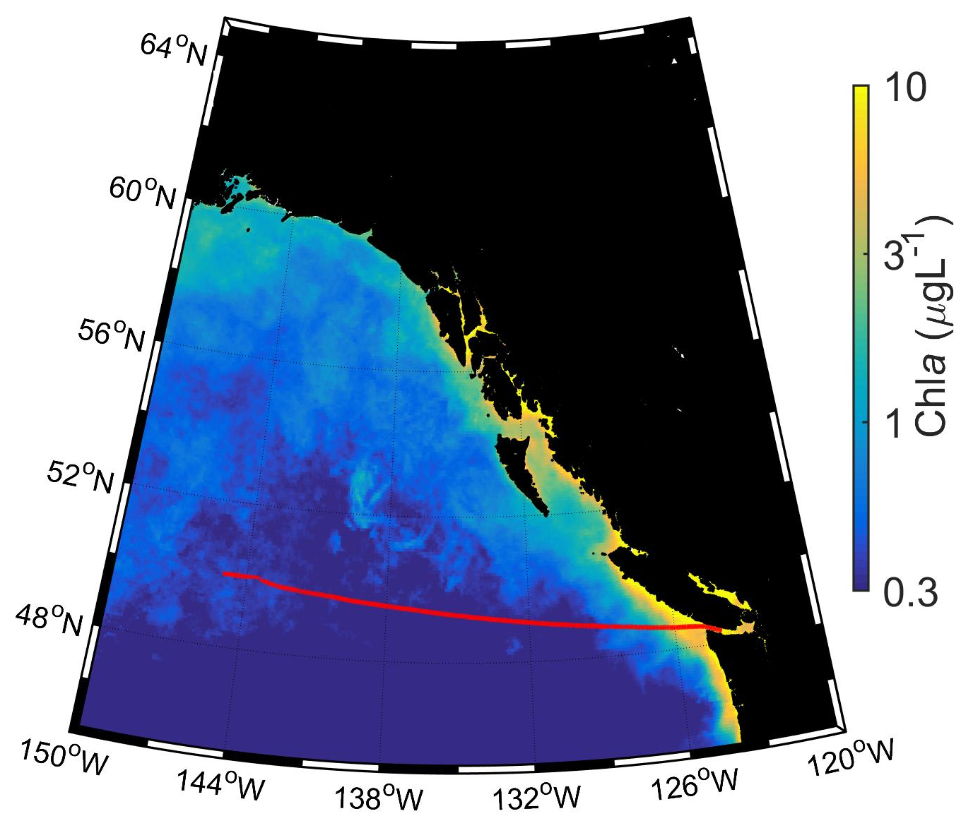
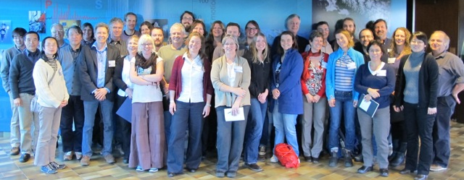
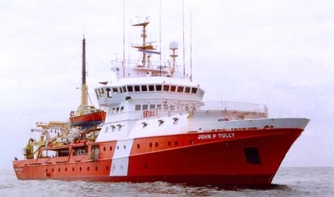
Congratulations DFO Line P Program!
60-year time series in the subarctic NE Pacific
1956 – 2016 and beyond !
Station P
Line P
Notes:
Before going any further, I want to give a Shout Out to the DFO Line P Program, which has built a 60 year time series at Station P! This is the primary reason the NOAA surface mooring is there.

